Slide 1
IRIS‘RECOGNITION USING OPENCV’
group7.py
Iris recognition.py
gorup_members:
[‘NIVETHA_N_URK2OIS1019’,
‘GEORGE_DAVID_D_URK2OIS1022’,
‘ARUN_PALANI_G_URK20IS1025’,
‘CELCIAMERLYN_R_URK20IS1038’,
‘SELVA_KUMARI_P_URK20IS1074’,
‘MOULIK_C_URK20IS1032’,
‘PRASATH_U_URK20IS1080’,
‘RAGHUL_R_URK20IS1038’,
‘ABDUR RAHMAN_R_URK20IS1031’,
‘SANTHOSHKUMAR_R_URK20IS1058’]
Iris recognition using opencv in python

Slide 2
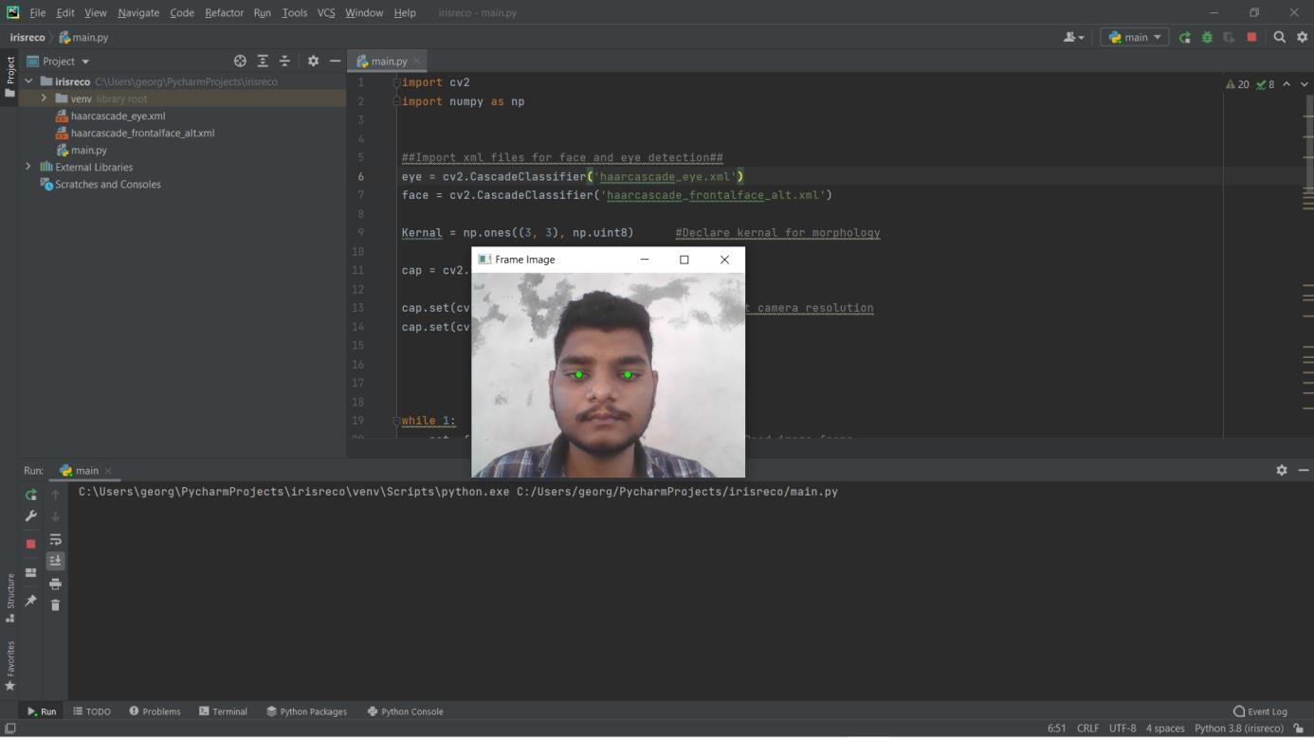
INTRODUCTION:
group7.py
Iris recognition.py
{
< We are going to do detect iris using OpenCv python. After executing this program we should open webcam and it will detect our iris >
}
Iris recognition using opencv in python

Slide 3
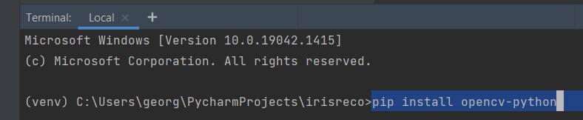
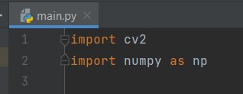
group7.py
Iris recognition.py
So, let's get started. We will start by install and importing the necessary libraries.
}
Iris recognition using opencv in python

Slide 4
{ STEPS:
group7.py
Iris recognition.py
< OpenCV is a Python open-source library (import as cv2), which is used for computer vision in Artificial intelligence, Machine Learning, face recognition, etc. ... Computer vision allows the computer to perform the same kind of tasks as humans with the same efficiency. In simple terms people use opencv for webcam related projects >
}
{
< NumPy is a Python library used for working with arrays. It also has functions for working in domain of linear algebra, fourier transform, and matrices. It is pre install library in all python IDE no need to install directly import it>
}
Iris recognition using opencv in python

Slide 5
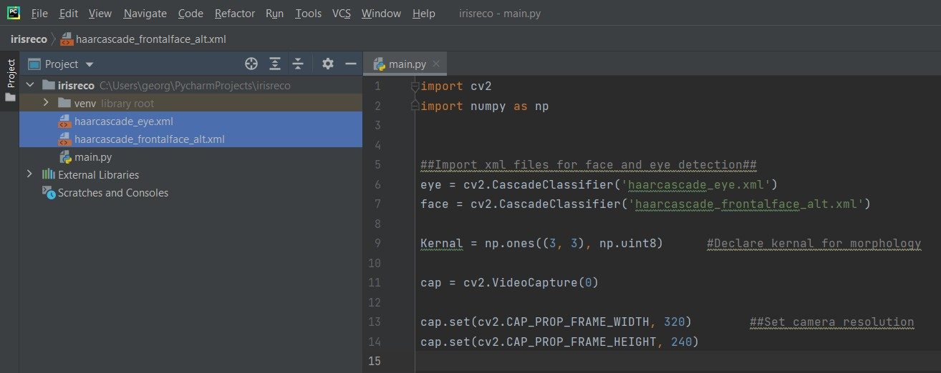
{CLASSIFIER;
group7.py
Iris recognition.py
}
Iris recognition using opencv in python

Slide 6
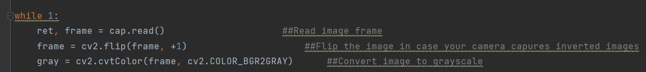
{
group7.py
Iris recognition.py
< In a while loop let us capture an image frame, flip it (in case your camera captures inverted images) and convert it into a gray scale image >
}
Iris recognition using opencv in python

Slide 7
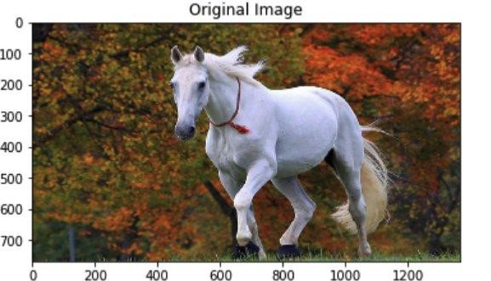
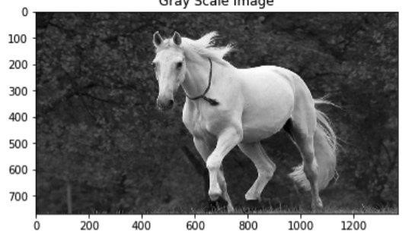
{ GREY SCALE IMAGE
group7.py
Iris recognition.py
}
Iris recognition using opencv in python

Slide 8
{
group7.py
Iris recognition.py
< detectMultiScale() requires three arguments. The first is the source image, the second is the scale factor which specifies how much the image size is reduced at each image scale and the third is the minimum neighbors which specify how many neighbors each candidate rectangle should have to retain it>
< This method returns the coordinates of the rectangle detecting a face. If you draw a bounding box using the coordinates, the output will be something as shown below>
}
Iris recognition using opencv in python

Slide 9
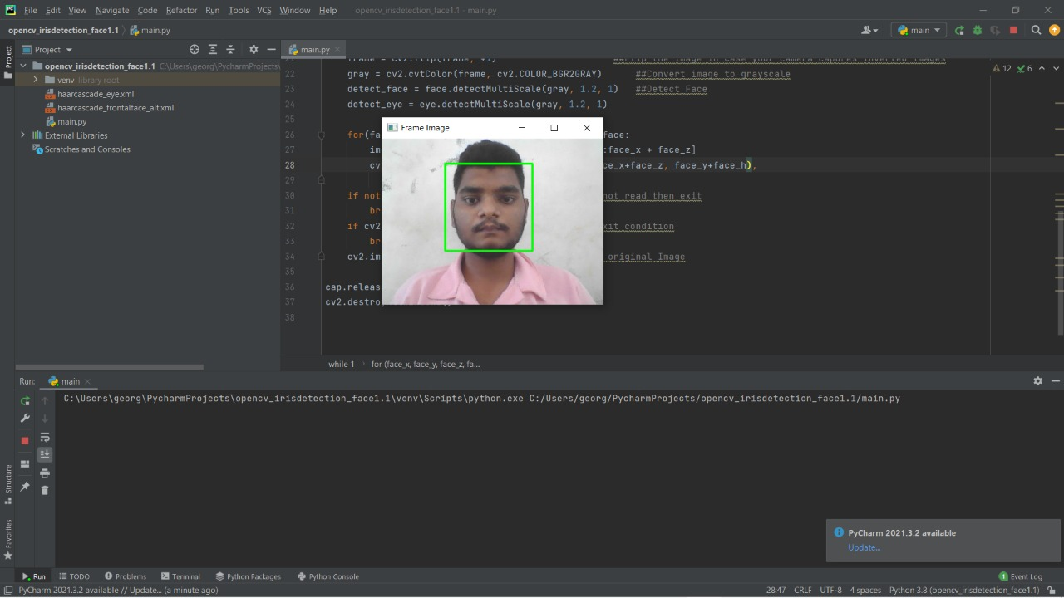
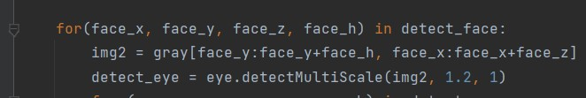
{
group7.py
Iris recognition.py
}
Iris recognition using opencv in python

Slide 10
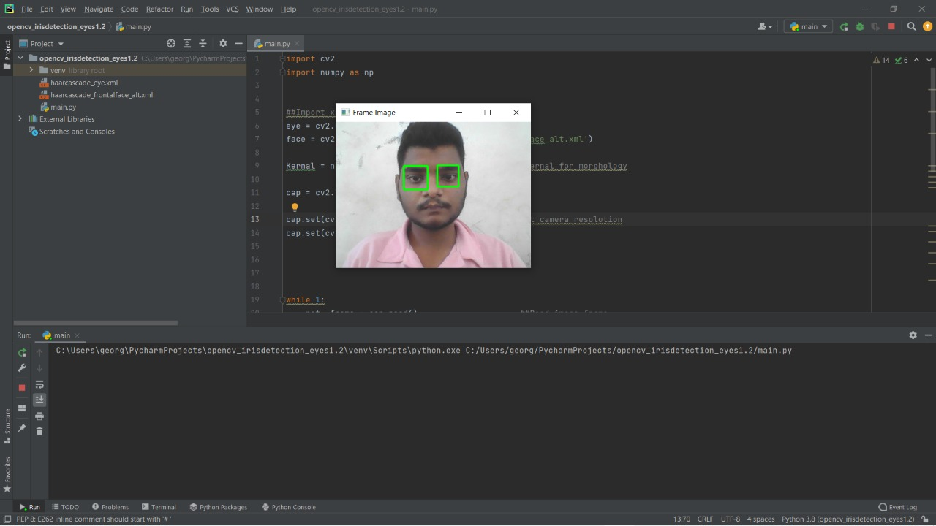
{
group7.py
Iris recognition.py
< img2 contains only the face image. detect_eye has the coordinates of all the eyes found in the face region(ideally 2 eyes). If you draw a binding box using the coordinates, the output image will be as below>
}
Iris recognition using opencv in python

Slide 11
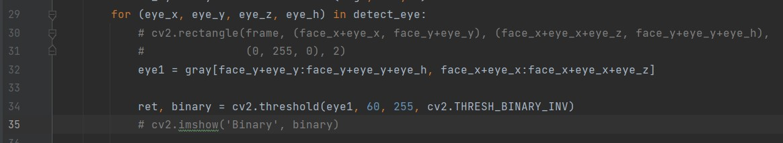

{
group7.py
Iris recognition.py
< Now using the eye as the region of interest we have to detect iris. To do that let us use binary thresholding to convert the grayscale eye image into a binary image <
< eye1 contains the image of only the eye extracted from the face image. binary contains the binary image of the eye1. 60 is the threshold value. This might vary as per the light conditions. The output of the above code is shown below >
}
Iris recognition using opencv in python

Slide 12
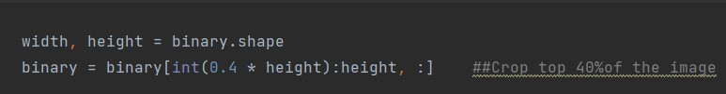

{
group7.py
Iris recognition.py
< As you can see in the above image, We have the iris as well as the eyebrow. We are only interested in the iris. So let us remove the eyebrow by cropping out the top 40% of the image>
< The new output is shown below>
}
Iris recognition using opencv in python

Slide 13
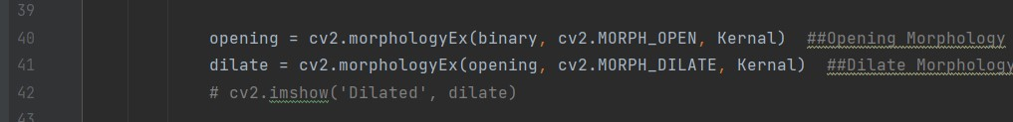

{
group7.py
Iris recognition.py
< To remove the noises in this image let us use image morphology >
< The output of the above code is as follows>
}
Iris recognition using opencv in python

Slide 14
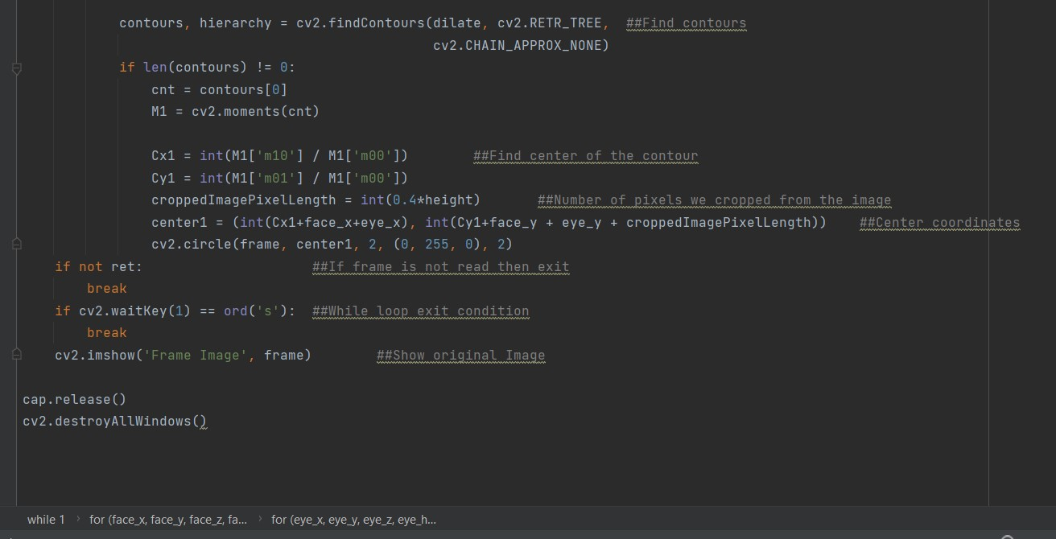
{
group7.py
Iris recognition.py
< Now we have the proper image of the iris. Let us now detect contours in the above image and then draw a circle around it >
}
Iris recognition using opencv in python

Slide 15
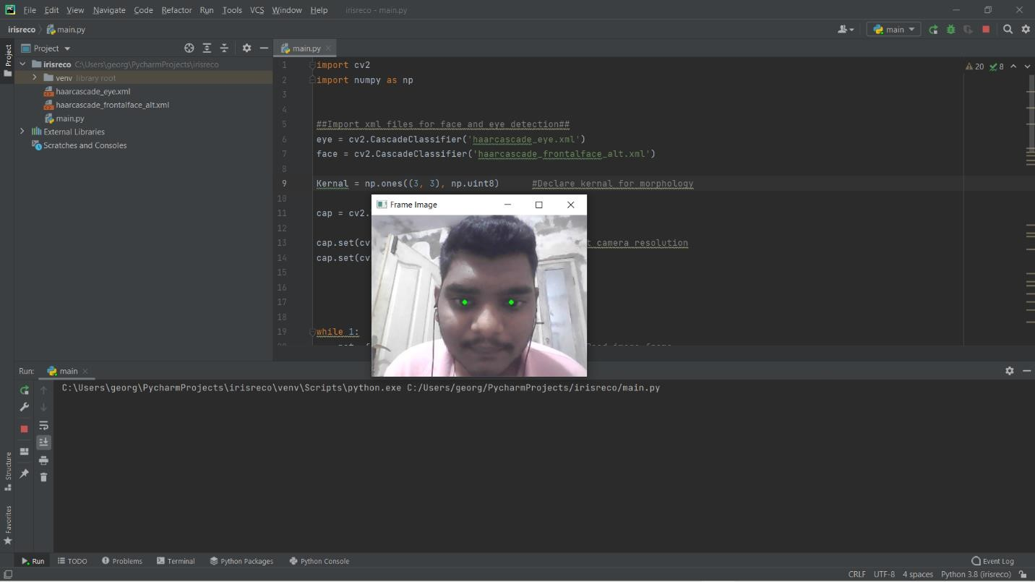
{
group7.py
Iris recognition.py
< Cx1 and Cy1 are the coordinates of the center of the contour with reference to the dilated image of the eye. center1 contains the coordinates of the center of the contour with reference to the original image(frame). cv2.circle draws the circle around the iris in the original image. Here is the final output>
}
Iris recognition using opencv in python

